Slide 1




Introduction to Intellectual Property Rights (Patent Database Searches) (3IT) 29th August 2025
Presenter: Karma Kelzang Eudon

Slide 2


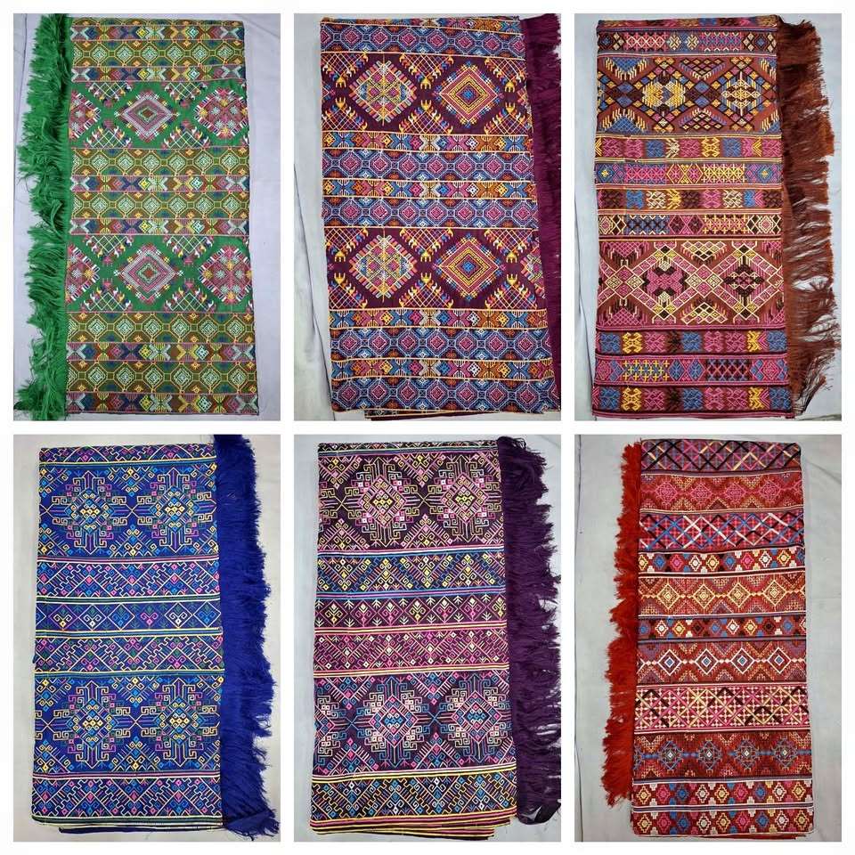

THOUGHTS????
2

Slide 3
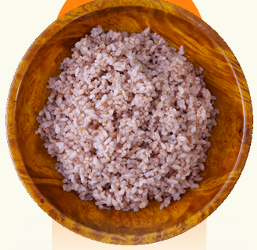
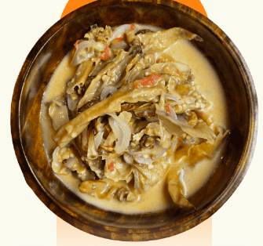
THOUGHTS????
3

Slide 4
Patent Document Information
Title
Abstract
Description, Drawings, Claims
Patent Publication, Application, Priority Number(s)
Dates
Classifications
Inventor, Applicant, Owner
Citations
Examiner
Country Information
Patent Family
4

Slide 5
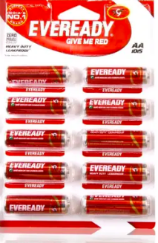
Types of Searches
State-of-the art searches (What solutions are there to my technical problem?)
5

Slide 6
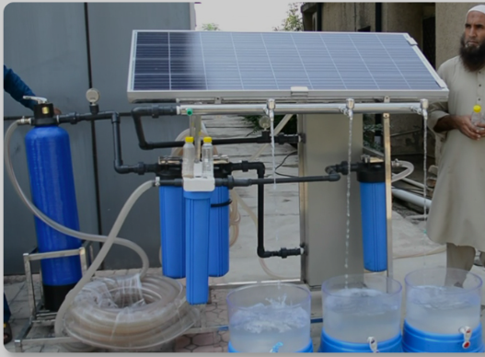
Types of Searches
Novelty/patentability searches (Can I obtain a patent for my invention?)
6

Slide 7
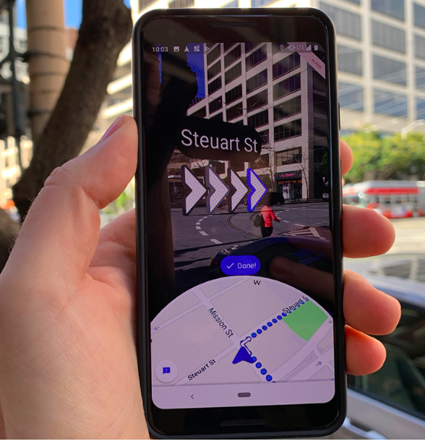
Types of Searches
Validity searches (Is this patent valid? Can it be legally challenged?)
7

Slide 8

Types of Searches
Name searches (What inventions has this individual or company been involved with?)
8

Slide 9
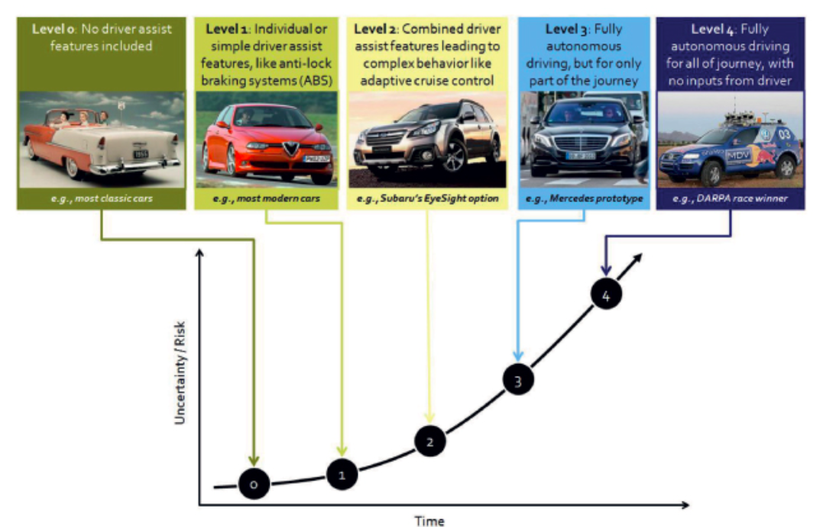
Types of Searches
Technological activity searches (How has this technology developed over time and who has been involved in its development?)
9

Slide 10

Types of Searches
Freedom to operate searches (Can I produce and/or commercialize this product in that country, has this patent been granted; is it in force?
10

Slide 11
Patent Database
The Intellectual Property Office keeps the Patent Register.
Electronic Patent Register contains the bibliographic data and legal status on the patent applications and registered patents.
Examples of Patentscope, WIPO:
Espacenet , EPO
USPTO, US
J-PlatPat, JPO
CNIPA, CP&SA
inPASS, Ipindia
11
Notes:
CNIPA = China National Intellectual Property and Administration
inPASS = Indian Patent Advanced Search System

Slide 12
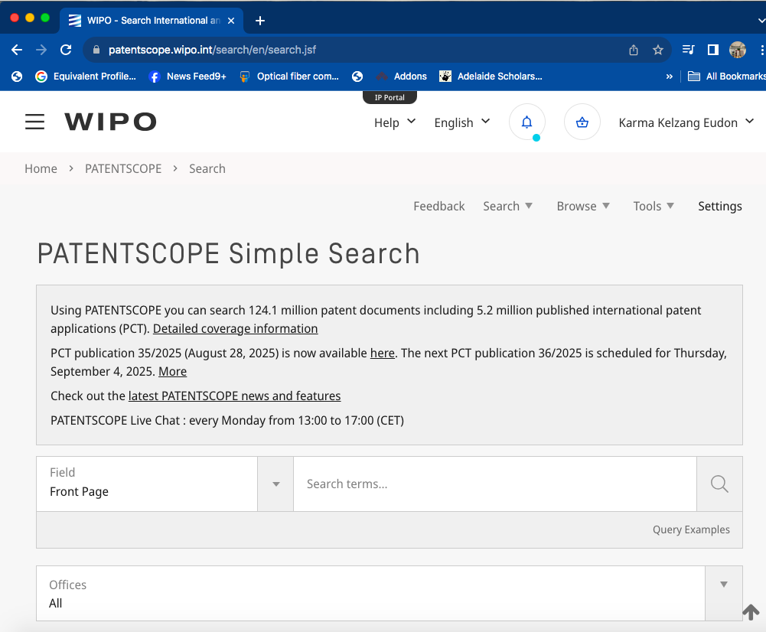
Patentscope, WIPO
https://patentscope.wipo.int/search/en/search.jsf
12

Slide 13
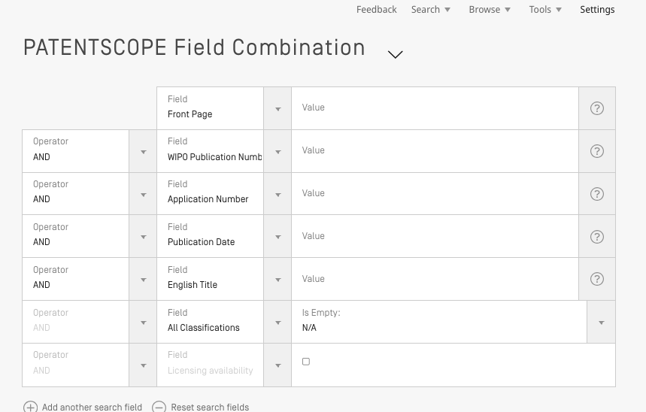
Patentscope, WIPO
https://patentscope.wipo.int/search/en/search.jsf
13

Slide 14
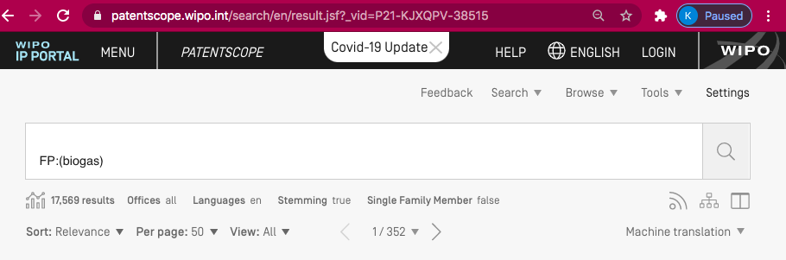
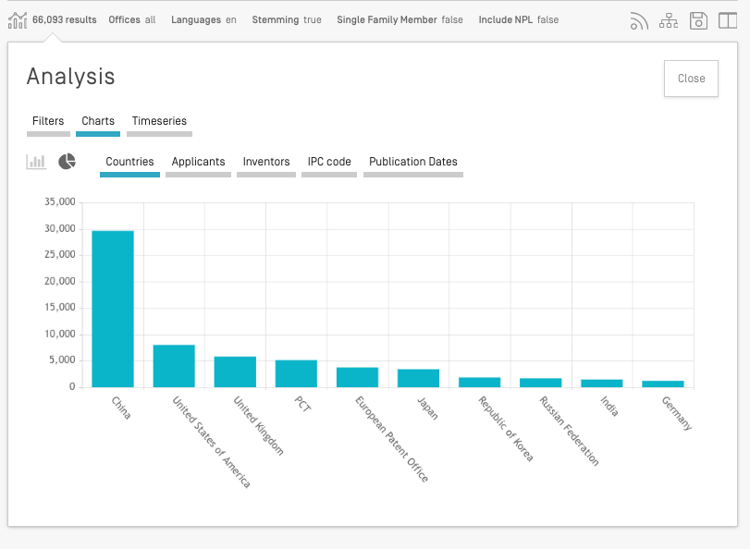
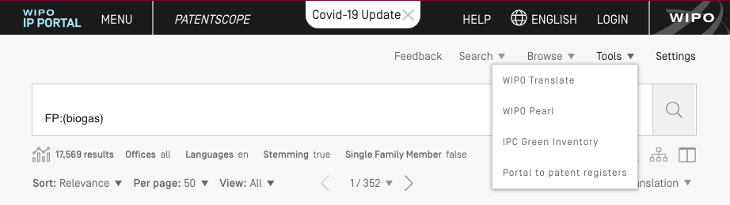
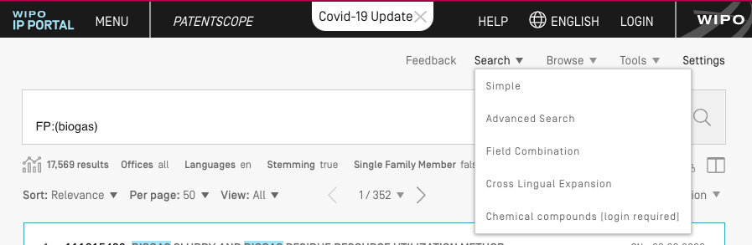
Patentscope, WIPO
the
14

Slide 15
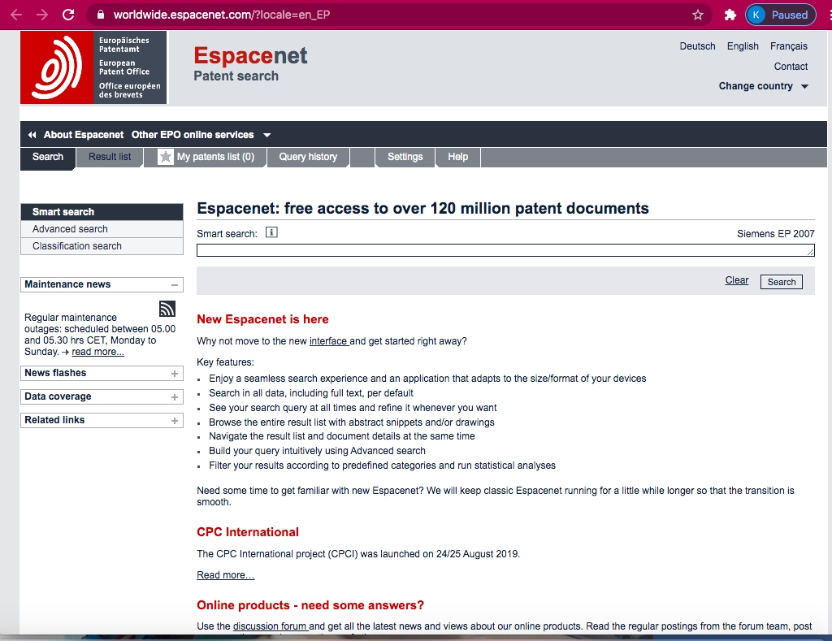
Espacenet, EPO
https://worldwide.espacenet.com/?locale=en_EP
the
15

Slide 16
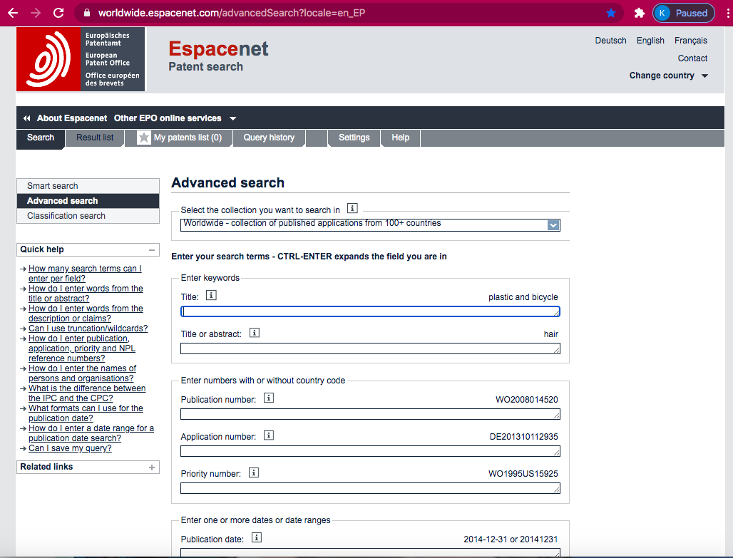
Espacenet, EPO
https://worldwide.espacenet.com/?locale=en_EP
16

Slide 17
Espacenet, EPO
17

Slide 18
Espacenet, EPO
18

Slide 19
IPC : International Patent Classification CPC: Cooperative Patent Classification
Aspect | IPC (International Patent Classification) | CPC (Cooperative Patent Classification)
Developer | Created by WIPO (World Intellectual Property Organization) | Created jointly by the European Patent Office (EPO) and U.S. Patent and Trademark Office (USPTO)
Coverage | Used worldwide as a common standard | Mainly Europe and U.S., but now adopted by many others
Structure | Sections → Classes → Subclasses → Groups → Subgroups | Same as IPC, but with extra layers and more detail
Level of Detail | Broader categories | Much more specific and fine-grained
Purpose | To make patents searchable across all countries | To improve search accuracy and handle new, complex technologies
Updates | Updated periodically by WIPO | Updated more often to keep pace with new inventions
Use in Espacenet | Always shown, useful for broad searches | Shown alongside IPC, useful for very precise searches
Example | IPC: A61K 8/00 = Cosmetics or toilet preparations (like all types of lotions, shampoos, makeup) | CPC: A61K 8/02 = Cosmetics specifically containing surfactants (e.g., a new type of foaming face wash)
19

Slide 20
Task 1
Search Activity - Finding CPC Symbols
a) Find the CPC symbol Y02C 20/10 and note the description of the symbol.
b) Find a patent application published in 2008, with CPC code Y02C 20/10, and "Zafar" as one of the inventors.
c) Was a patent corresponding to the identified patent application granted? If yes, then give details on number, issue date and ownership.
20

Slide 21
Task 2
Search Activity - Finding CPC Symbols for various technologies
Which CPC symbol would be the most relevant for an invention relating to:
a) Energy generation through renewable energy sources
b) Medicinal preparations containing peptides
c) Automatic musical instruments
d) Woven pile fabrics
e) Data switching networks
21

Slide 22
Task 3
Search Activity - Finding a patent where the inventor has a common name
Luxury Bath Fittings Inc. is a company which manufactures bath fittings such as faucets, wash basins, bath tubs, shower panels, shower heads etc. Recently their researchers came across a patent US6263524 that mentions a shower head which provides an entertaining display of moving objects while in the shower.
22

Slide 23
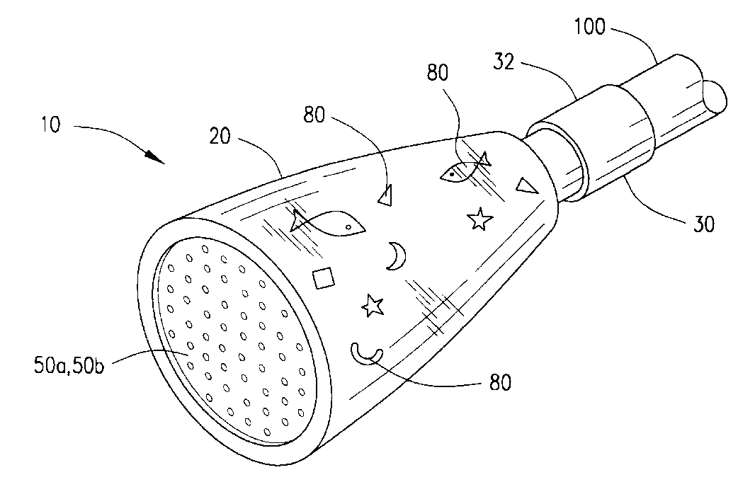
Task 3
23

Slide 24
Task 3
Intrigued by the patent, the researchers want to know if they could use the idea of floating objects, for example fish, in a bath tub to make it both decorative and appealing for their customers. They have information on a bath tub designed in combination with an aquarium by an inventor whose second name is Robinson. Can you help the researchers find the patent number and its date of issue?
24

Slide 25
Task 4
Search Activity – How could Boolean operators help with this search?
Using the same example as in Search Activity 4.4.1, which of the following search strings do you think it would be best to use in the Patentscope simple search page
(1) sludge AND waste
(2) sludge OR waste
(3) mycelium AND bacteria
(4) "peracetic acid" AND waste
25

Slide 26
Task 5
Search Activity - Finding the patent document for the pop-up toaster
The best thing since sliced bread, but it was actually invented before sliced bread. See if you can find the application number, and locate the patent document of the pop-up toaster by Charles Strite applied for in 1920.
26

Slide 27
Task 6
Search Activity - Finding the patent document for the “Hoverboard”
27

Slide 28

Thank You
28
Project for Change : Bhutan 2019-2020

Slide 29
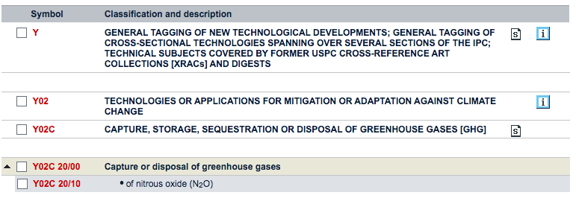
Task 1
29

Slide 30
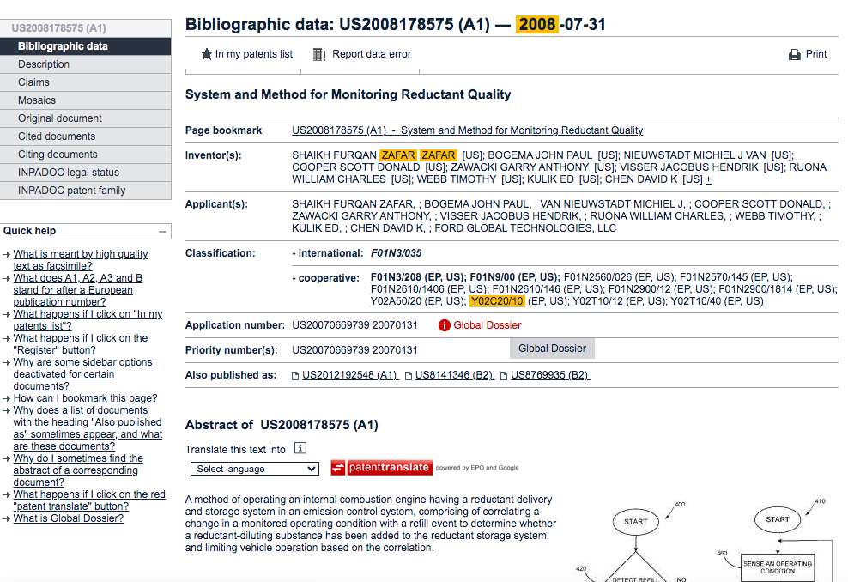
Task 1
30

Slide 31
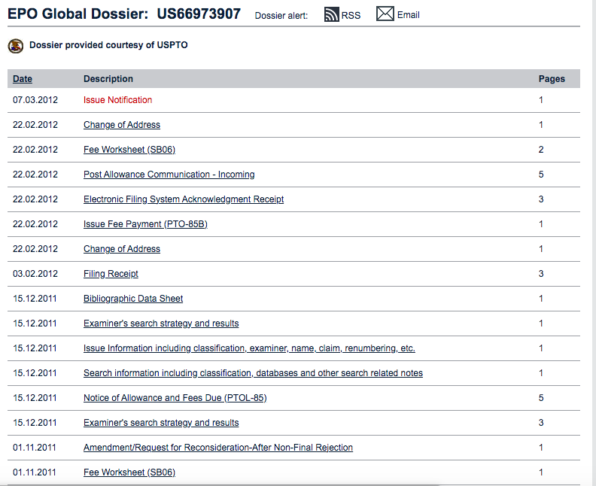
Task 1
31

Slide 32
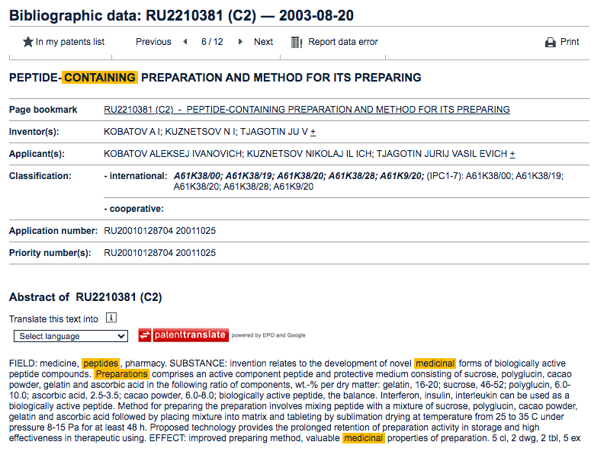
Task 2
32

Slide 33
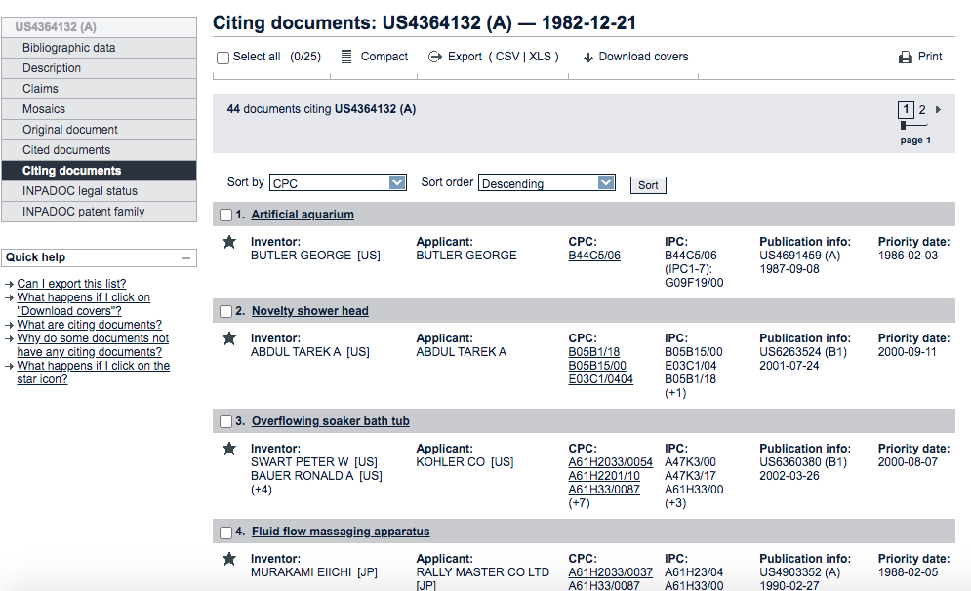
Task 3
33

Slide 34
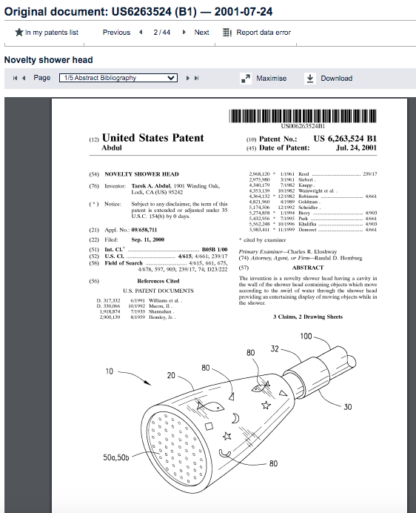
Task 3
34

Slide 35
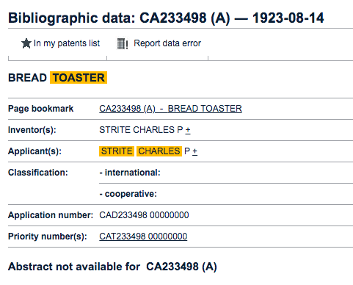
Task 5
35

